Slide 1
DIVERTGUARD · drugdiversionprevention.com
Drug diversion is a documented,
expensive, preventable failure
— and the controls that stop it are known
The case for a prevention programme, evidenced from 686 documented US cases rather than industry estimates. Every figure cites a public source.
686
51
$43.5M
22
documented cases
states
in recorded penalties
with a death or overdose

Slide 2
EXECUTIVE SUMMARY
The documented downside already exceeds the cost of preventing it
1
Diversion is expensive and public: 686 documented cases in 51 states, $43.5M in recorded settlements and fines.
2
Organisations pay for the control failure: health systems have paid $32.8M across 37 cases, roughly three times what individuals paid.
3
It is found late because nobody owns the metric: cases surface from audits, tips or patient harm rather than from a control that worked.
4
The controls are known and cheap relative to the loss: trended reconciliation, access proportionality, independent audit, and one named owner.
RECOMMENDATION
Fund a named diversion-prevention owner and a trended reconciliation programme. A single avoided six-figure settlement pays for it for years, and the documented cases are the evidence a board will act on.
All figures computed from the DivertGuard registry via case_stats (the same source the site charts use).
DivertGuard | 2

Slide 3
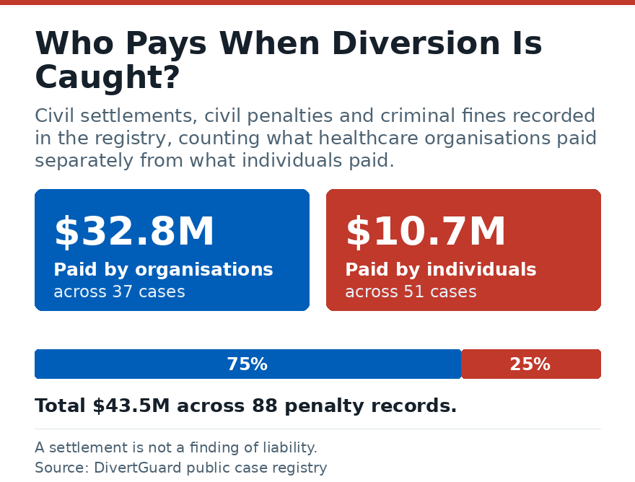
SITUATION
686 cases across 51 states — the exposure is national, not local
686
51
$43.5M
22
documented diversion and compliance cases in the public record
states represented — every region of the US
recorded settlements, fines and penalties
cases involving a death or fatal overdose
WHO PAYS
Organisations are penalised for the control failure, not only the individual. Every figure is an amount stated in a cited public record.
Sources: state board orders, agency releases, court and settlement records, news reports — each case page links its own.
DivertGuard | 3

Slide 4
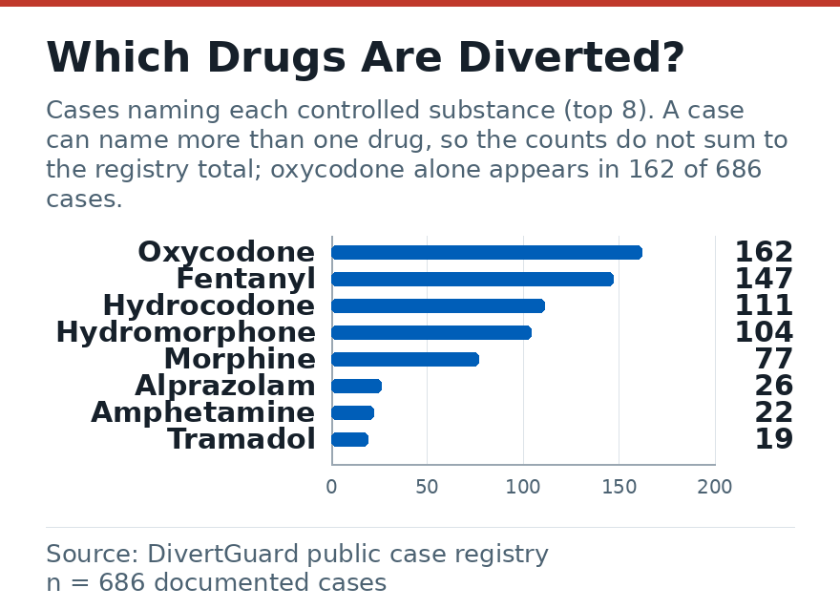
COMPLICATION
Oxycodone and fentanyl account for 45% of all named substances
WHAT THIS MEANS
Two drugs dominate the public record. A programme that trends only total waste would miss the concentration that matters.
READ IT CAREFULLY
Counts come from what the record names, so a drug that is rarely named is not evidence it is rarely diverted — propofol and midazolam are almost certainly under-documented in public board records.
DivertGuard registry, 686 cases. Chart and table share one parser, so they cannot disagree.
DivertGuard | 4

Slide 5
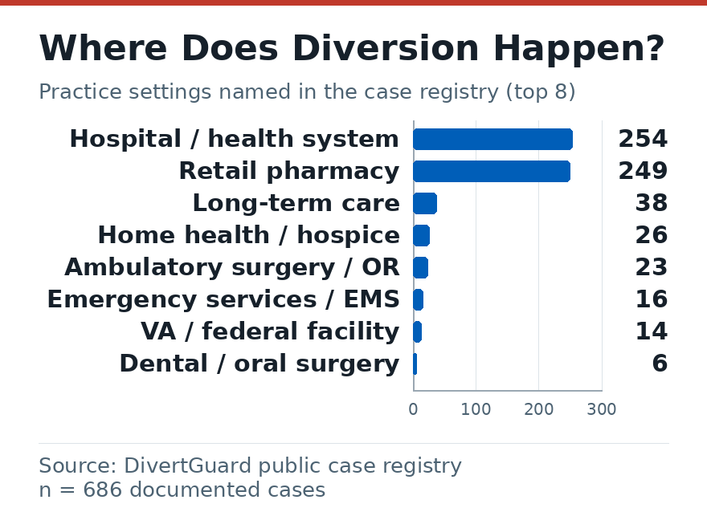
COMPLICATION
Hospitals and retail pharmacies carry 73% of documented exposure
THE CONTROL POINT
These are the settings with the largest controlled-substance footprint and the most handoffs between dispensing, administration and waste — which is exactly where reconciliation has to close the loop.
SMALLER SITES
Long-term care, home health and ambulatory surgery appear too, and usually with fewer witnesses per transaction.
Setting named in each case record; cases naming no setting are excluded, not guessed.
DivertGuard | 5

Slide 6
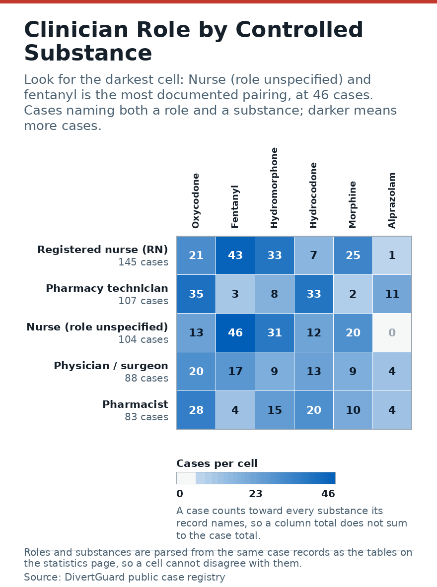
COMPLICATION
Nursing roles appear in the majority of documented cases
WHERE TO LOOK
Registered nurse (RN) is the most common single role (145 cases). Reading the matrix across a row shows which substances that role actually handles, which is more specific than role or drug alone.
FAIRNESS CHECK
This is a record of who was caught and published, not a claim about who diverts. Roles are taken from each record; cases naming none are excluded.
Roles and substances parsed from the same records as the tables on the statistics page.
DivertGuard | 6

Slide 7
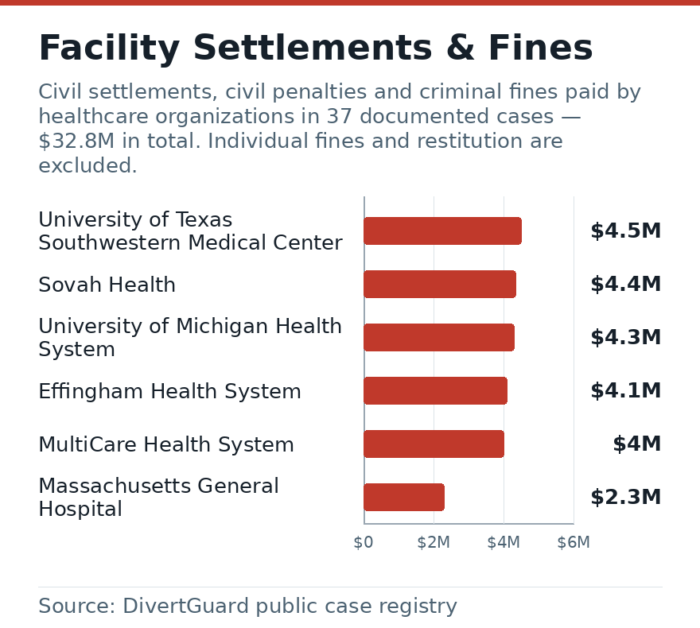
COMPLICATION
Health systems have paid $32.8M — about 3x what individuals paid
THE ARITHMETIC
$32.8M across 37 organisational cases. A single avoided six-figure settlement funds a prevention programme for years.
THE CAVEAT
A settlement is not a finding of liability, and these are separate matters over many years — not a single-year total.
Amounts only where a cited public record states a figure; individual and facility totals kept separate.
DivertGuard | 7

Slide 8
COMPLICATION
22 documented cases involve a death or fatal overdose
This is the number that ends the debate about whether prevention is a safety matter or a finance matter.
TX
UT Southwestern Pays $4.5M Over Staff Fentanyl Diversion and Two Nurse Overdose Deaths
NH
Cheshire Medical Center Pays $2 Million After Nurse Stole Fentanyl IV Bags
NH
Traveling Radiologic Technologist Sentenced for Fentanyl Diversion and Multistate Hepatitis
MA
Haverhill Nurse Sentenced for Tampering with Hospice Patient's Morphine
PA
Bucks County Dentist Pays $150,000 for Opioid Diversion and Recordkeeping Violations
VA
Virginia Rite Aid Pharmacist Pleads Guilty to Filling Fraudulent Prescriptions in Pets' Name
MA
Westfield Nursing Facility Nurse Diluted Hospice Patient's Morphine
Cases where the public record states a death, overdose or fatal consequence; 22 of 686 cases.
DivertGuard | 8

Slide 9
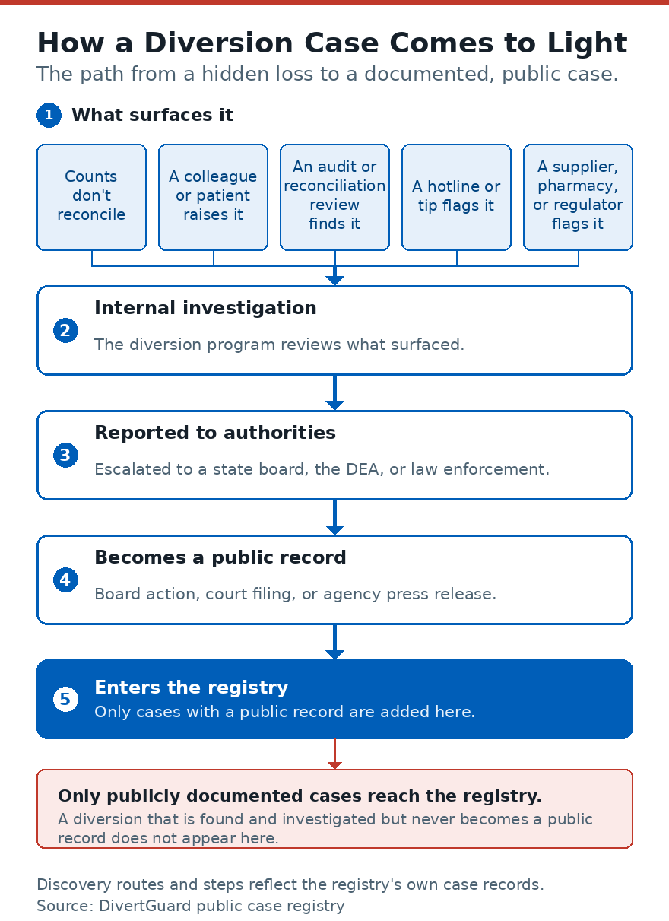
RESOLUTION
Diversion surfaces at five stages — and every stage has a control
THE PATTERN THAT REPEATS
Waste is documented but never trended. Discrepancies are closed locally as clerical error. Access is broad. Nobody owns the metric, so nobody sees the drift.
WHY IT IS FOUND LATE
Detection usually comes from an audit, a tip or a patient harmed — rarely from the control itself.
Stages and controls as described in the registry's own case records.
DivertGuard | 9

Slide 10
RECOMMENDATION
Start with trended reconciliation and one named owner
1
Reconciliation that trends: waste, override, dispensing and return matched per user and per shift — not filed, trended.
2
Access proportionality: the smallest number of people who can reach each substance, reviewed quarterly.
3
Independent audits on a schedule: with results reported to a body that can act on them.
4
A named owner and a metric: with a documented escalation path that does not depend on a manager volunteering it.
5
Board-facing evidence: the artefacts you could hand a surveyor today to show the programme was operating.
Next step: run the free self-assessment at drugdiversionprevention.com, then take the two highest-risk units and trend waste and overrides for one quarter.
Every figure in this deck comes from the DivertGuard registry (686 cases, 51 states), each with a cited public source.
DivertGuard | 10

